Slide 1
Luca Porcu & Chandra Chilamakuri (Bioinformatics core)
21st February 2025
Linear regression models
Fixed-effects models

Slide 2
Process flow
Stage 1
Stage 2
Stage 3
Stage 4
Effects and regression models
Analysis of variance (ANOVA)
Simple regression model
Multivariable regression model

Slide 3

Effects
Definition and classification
09.00 - 09.15 am

Slide 4
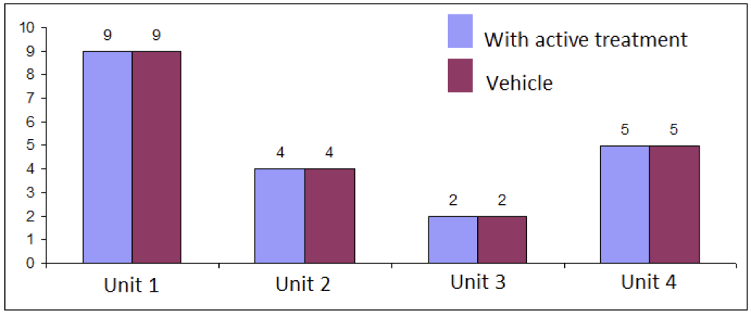
Definition
4
Number of metastases
Each unit exhibits a response that is observed some time after exposure (treatment).
Definition of “no effect”: each unit would exhibit the same value of the response whether assigned to exposure or not. If changing the exposure assigned to a unit changed the unit’s response then the exposure has at least some effect.

Slide 5

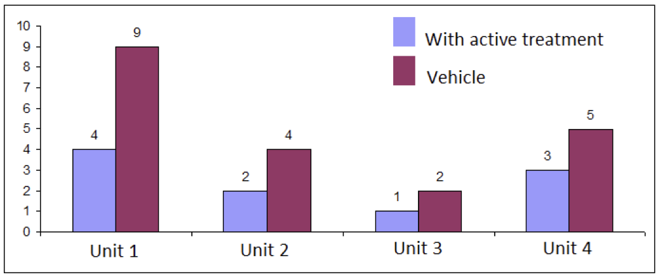
Examples of effects
5
Number of metastases
N° of metastases in the treated group: 10
N° of metastases in the vehicle: 20
This effect is understandable, easily detectable and systematic

Slide 6

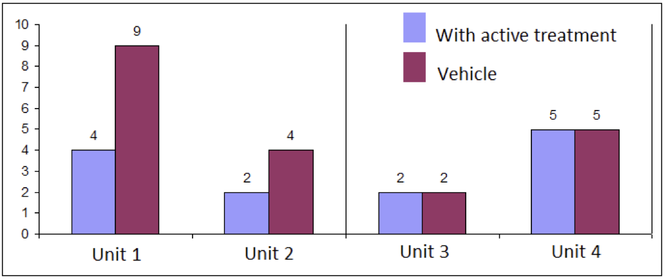
Examples of effects
6
Number of metastases
Experimental group | Male mice | Female mice
Active | 6 | 7
Vehicle | 13 | 7
This effect is understandable, detectable with sufficient units and systematic

Slide 7

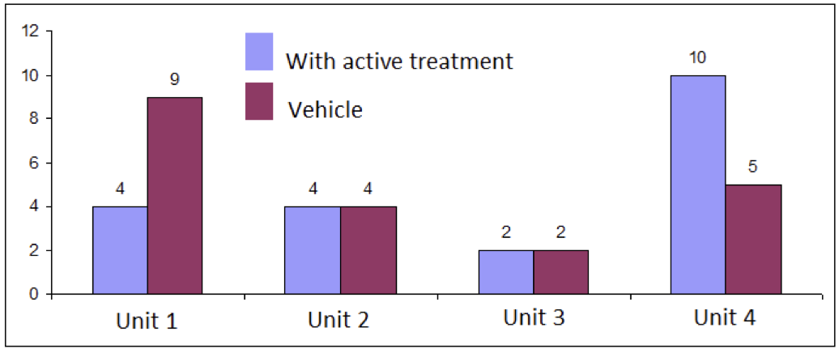
Examples of effects
7
Number of metastases
N° of metastases in the treated group: 20
N° of metastases in the vehicle: 20
This effect can someday be understood, not easily detectable and unsystematic

Slide 8
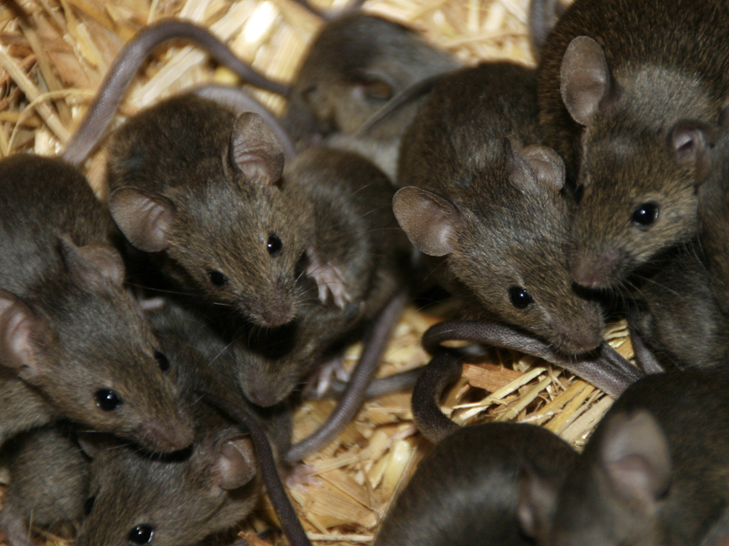

Different sources of effects
8
Treatment
Carboplatin + Tamoxifen
Response
Carboplatin alone

Slide 9
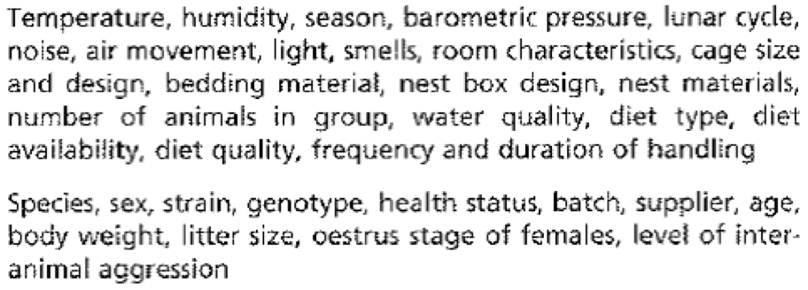
Different sources of effects
9
Environment and features of experimental units

Slide 10

Different sources of effects
10
The operator
Calibration of instruments
Measurement errors
Recording errors
Preparation of test materials
Operative procedures

Slide 11

Classification of effects
11
Fixed effects
Effects attributable to a finite set of levels of a source (i.e. predictor in statistical terms) that occur in the data and which are there because we are interested in them. Fixed effects are parameters associated with an entire population.
Treatment | Sex | Genotype | Time

Slide 12
Classification of effects
12
Random effects
Effects attributable to a (usually) infinite set of levels of a source (i.e. predictor), of which only a random sample are deemed to occur in the data. Random effects are associated with individual observational units drawn at random from a population.
Mouse | Litter | Batch | Laboratory

Slide 13
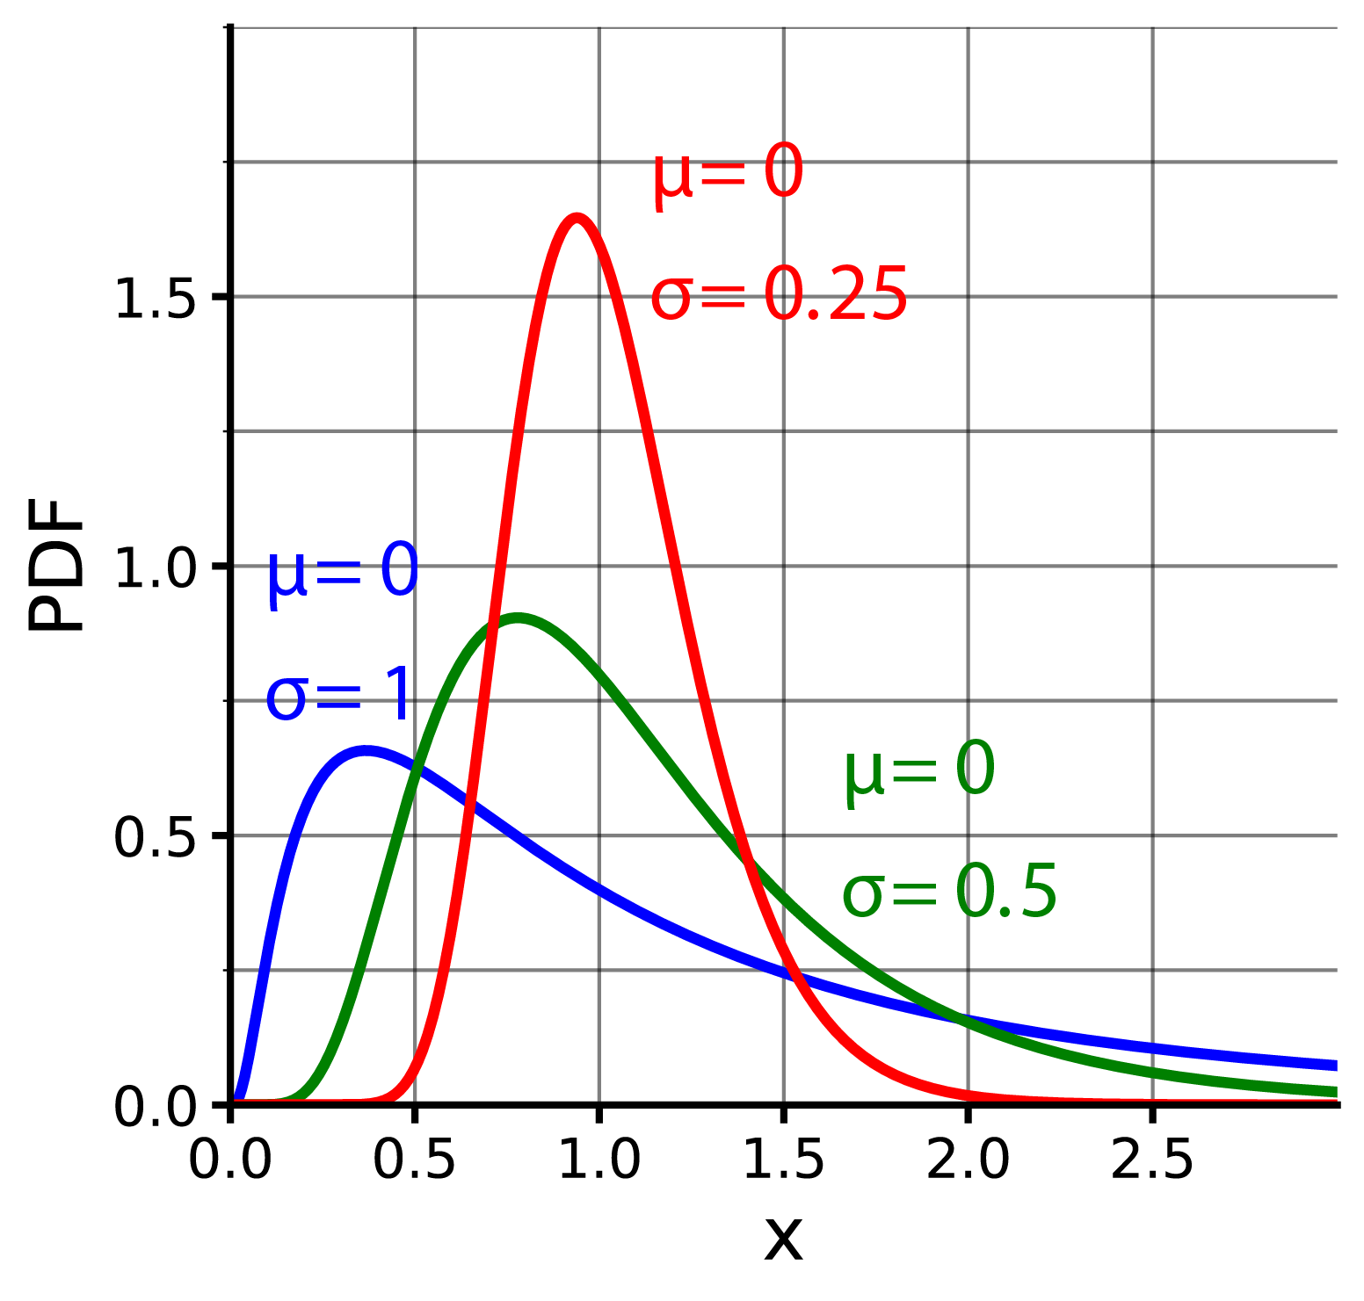
Classification of effects
13
Unpredictable effect (i.e. error)
Unpredictable effect attributable to “hidden” sources whose consequence is the deviation of the observed value from the “true value” of the population (i.e. fixed effects) or the individual observational unit (i.e. random effects).
At any given combination of age, gender, height, smoking status and place of residence, many different values of FEV (lung capacity) could be recorded, and so produce a distribution of recorded FEV values. At this given combination of age, gender, height, smoking status and place of residence, the distribution of FEV values has a unique mean FEV (“the true value”).

Slide 14
Regression models
Definition and classification
09.15 - 9.30 am

Slide 15

Definition
15
A regression model describes mathematically the population distribution of the response (e.g. FEV distribution in UK) as a function of fixed effects (e.g. age, gender, height, smoking status), random effects (e.g. place of residence) and error.
y_{i} = f(x_{1,i},..,x_{n,i}; x_{n+1,i},…, x_{n+k,i}; 𝜺_{i})
where i is the observational unit of the population.
Hi, my name is Mark Brown. I am 35 years old, male, 1.75 meters tall and ex-smoker. I live in Cambridge, UK. This morning my FEV is 4.73 liters in 1 second.

Slide 16
Definition
16
Every regression model consists of two components.
Component | Meaning | Example
Systematic component | It describes the relationship between the predictors and the population parameter of interest (e.g. mean) | 𝝁 = 𝜷₀ + 𝜷₁x₁ +… + 𝜷_{n} x_{n,} where x₁,..,x_{n} could be fixed and random predictors
Random components | It describes the properties of random effects and error | Random effects are normally distributed | N (0, 𝝈_{random} ) | N (𝛍_{random} = 0, 𝝈_{random})
 |  | Error is normally distributed | N (0, 𝝈_{error} ) | N (𝛍_{error} = 0, 𝝈_{error})
 |  | Error variance is constant | 𝝈_{error}² = constant | 𝝈_{error}² = constant

Slide 17
Examples of regression models
17
Model | Component | Structure
1 | Systematic | 𝝁 (Y) = 𝜷₀ + 𝜷₁x₁ +… + 𝜷_{n} x_{n}
 | Random | Random effects and error are normally distributed. Random and error variances are constant.
2 | Systematic | log [𝝁 (Y)] = 𝜷₀ + 𝜷₁x₁ +… + 𝜷_{n} x_{n}
 | Random | Random effects and error are log-normal distributed. Random and error variances on log scale are constant.
3 | Systematic | Median (Y) = 𝜷₀ + exp(𝜷₁x₁) +… + exp(𝜷_{n}x_{n})
 | Random | Random effects are normally distributed. Random variances are constant.
 |  | Error is exponentially distributed. Random variances are constant.
Legend: Y = response; x₁,…x_{n} = fixed and random effects; exp = exponential function; 𝜷₀ ,𝜷₁,…,𝜷_{n} = coefficients (i.e. parameters) of the regression model to estimate

Slide 18
Assumptions of linear regression models
18
Component | Assumption | Meaning
Systematic component | Population mean | We are interested to describe the population mean on natural scale | 𝝁
 | Linearity | The coefficients are assumed to combine the effects of the predictors linearly | 𝜷₀ + 𝜷₁x_{i} +… + 𝜷_{n} x_{i}
Random components | Random effects | They are normally distributed | N (0, 𝝈_{random})
 | Error | Error is normally distributed | N (0, 𝝈_{error})
 |  | Error variance is constant | 𝝈_{error}² = constant

Slide 19
Linear fixed-effects and mixed-effects models
19
A linear model that incorporate only fixed effects is called linear fixed-effects model (or merely linear model).
A linear model that incorporate both fixed and random effects is called linear mixed-effects model.

Slide 20
Hands on
https://bioinformatics-core-shared-training.github.io/ Fixed-and-Mixed-effects-models/

